Slide 1
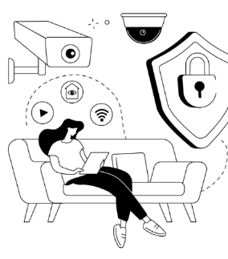
Smart Security System
Team Members:
SriKhyati Boppana
Gnanaprakash Mohana Rengan
Institut für IT-Sicherheit
Lübeck, 08.07.2026

Slide 2
Project Overview
The Smart Security System is an IoT-based solution designed to enhance security and safety in indoor environments.
The system uses an ESP32 microcontroller connected to multiple sensors and actuators to:
Detect unauthorized motion using a PIR sensor.
Trigger local alarms using a buzzer.
Monitor ambient temperature.
Allow secure access using a keypad.
Send real-time sensor data to the FIWARE Orion Context Broker.
Provide remote monitoring through cloud-based dashboards.
This project demonstrates IoT concepts including sensing, communication, cloud integration, real-time monitoring, and event-driven automation.

Slide 3
Problem Statement
Traditional security systems are often expensive and lack flexibility.
Challenges:
Intrusion detection requires continuous monitoring.
Temperature anomalies may indicate fire hazards.
Unauthorized access should trigger alerts immediately.
Users need real-time visibility into security events.
Our solution addresses these issues through a low-cost IoT architecture based on ESP32 and FIWARE.

Slide 4
Project Objectives
Security Objectives
Detect human motion in monitored areas.
Trigger alarms upon intrusion.
Authenticate users through a keypad.
Monitoring Objectives
Continuously monitor room temperature.
Upload sensor readings to the cloud.
IoT Objectives
Connect devices to Wi-Fi.
Integrate with FIWARE Orion Context Broker.
Visualize data remotely.
Demonstrate real-time IoT communication.

Slide 5
Use Cases
Smart Home Security
Office Security
Laboratory & Server Room Monitoring
Warehouse Monitoring
Healthcare & Pharmacy Storage
Educational Institutions
Remote IoT Monitoring

Slide 6
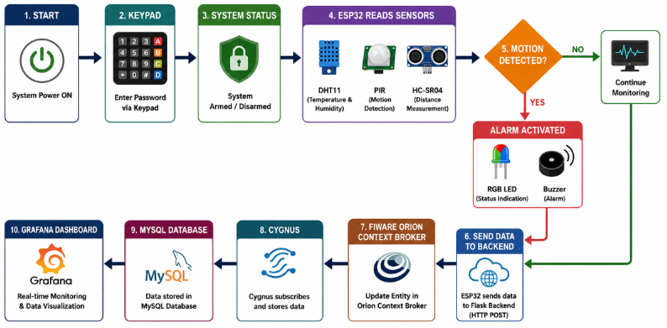
System Workflow

Slide 7
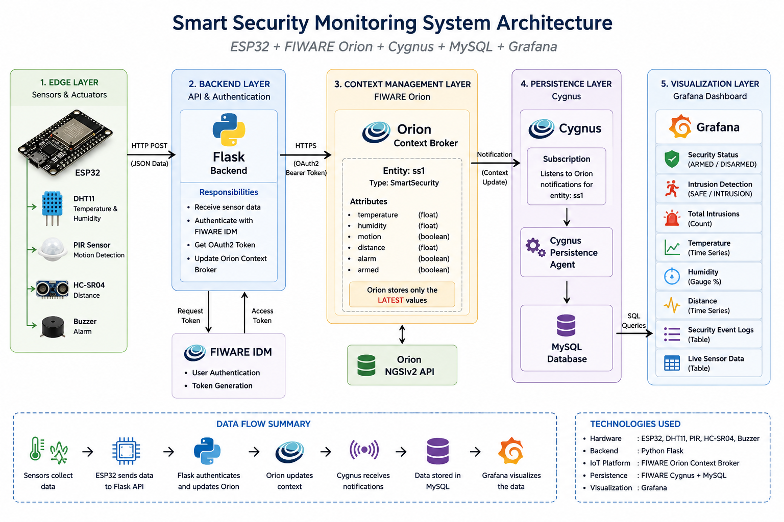
System Architecture
Notes:
Sensors collect environmental data. ESP32 processes sensor inputs. Events are transmitted through Wi-Fi. FIWARE stores and manages context information. Dashboard displays real-time values.

Slide 8
Hardware Components
Hardware Component | Purpose
ESP32 DevKit | Main controller for sensor integration and communication
DHT11 Sensor | Measures temperature and humidity
PIR Motion Sensor | Detects human movement
HC-SR04 Ultrasonic Sensor | Measures object distance
4×4 Keypad | Arms and disarms the security system
RGB LED | Indicates system status (armed, disarmed, alarm)
Active Buzzer | Generates audible alarm notifications
Breadboard | Prototype circuit assembly without soldering
Jumper Wires | Electrical connections between components

Slide 9
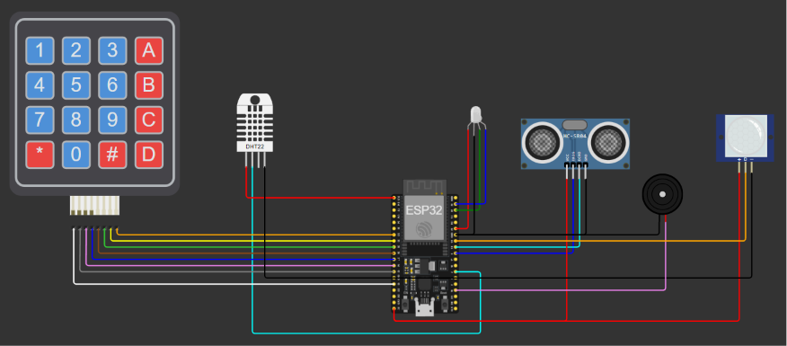
Fizzing Diagram
DHT11
RGB LED
Ultrasonic Sensor
Buzzer
Keypad
PIR Sensor
ESP32

Slide 10
Implemented Features
Real-Time Monitoring
🌡 Temperature
💧 Humidity
🚶 Motion
📏 Distance
Smart Security
🔐 Arm/Disarm
🚨 Buzzer Alarm
🔴 RGB Status
Data Management
☁ HTTP Communication
🗄 MySQL Storage
📊 Dashboard

Slide 11
PIR Motion Detection
Working Principle
PIR sensor detects infrared radiation changes.
Human movement changes the IR pattern.
ESP32 receives HIGH signal.
Motion event is generated.
Actions
Motion detected message.
Buzzer activated.
Event uploaded to FIWARE.

Slide 12
Intrusion Alert using Keypad
Feature Added
The keypad introduces an authentication mechanism.
Working
User enters PIN.
ESP32 verifies PIN.
If PIN is correct:
Access granted.
Alarm disabled.
If PIN is incorrect:
Intrusion alert generated.
Buzzer sounds.
Event uploaded to FIWARE.
Benefits
Prevents unauthorized access.
Adds another security layer.

Slide 13
Temperature Monitoring
Feature Added
Temperature sensor continuously measures ambient temperature.
Functions
Read temperature every few seconds.
Display readings on Serial Monitor.
Send temperature values to FIWARE.
Safety Scenario
If temperature exceeds threshold:
Warning generated.
Potential fire hazard indication.
Alert can be sent to dashboard.

Slide 14
FIWARE Integration
Why FIWARE?
FIWARE provides:
Context management
IoT data handling
Real-time updates
Open-source ecosystem
Orion Context Broker
Stores entities such as:
{
"id": "urn:ngsi-ld:MotionSensor:001",
"type": "MotionSensor",
"motion": {
"value": true
}
}

Slide 15
Data Persistence
Sensor readings are automatically stored in MySQL using Cygnus.
Stored Information:
Timestamp
Temperature
Humidity
Distance
Motion Status
Armed Status
This enables historical analysis and long-term monitoring.

Slide 16
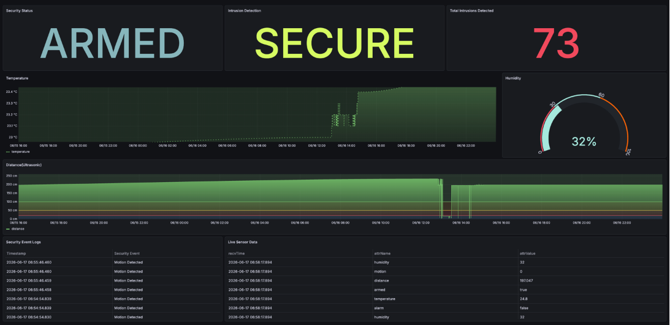
Grafana Dashboard
Notes:
Sensors collect environmental data. ESP32 processes sensor inputs. Events are transmitted through Wi-Fi. FIWARE stores and manages context information. Dashboard displays real-time values.

Slide 17
Dashboard Panels
System Status Displays: SYSTEM ARMED Indicates whether the security system is active.
Intrusion Detection Shows the latest motion detection status.
Values: SECURE or INTRUSION DETECTED
Total Intrusion Count Displays the total number of times motion was detected.
Purpose: - Security analytics - Event frequency monitoring

Slide 18
Dashboard Panels
Humidity Monitoring Visualization Type: Gauge
Thresholds:
Distance Monitoring Visualization Type: Time Series Graph Displays object proximity measurements from the ultrasonic sensor.
Security Event Log Contains: - Timestamp - Sensor Attribute - Sensor Value
Provides historical records of all security events.
Range | Status
0 – 30 % | Dry
30 – 60 % | Normal
60 – 100 % | Humid

Slide 19
Results
Achievements
Real-time monitoring
Motion detection
Data persistence
Dashboard visualization
Historical analysis
Benefits
Scalable
Modular
Low-cost
Easy to extend
Cloud-ready

Slide 20
Future Enhancements
Camera integration.
Mobile notification system.
Face recognition.
RFID authentication.
SMS/Email alerts.
Cloud analytics dashboard.
Mobile application.

Slide 21
Conclusion
This project successfully demonstrates a complete IoT-based security and monitoring solution using ESP32 and FIWARE.
The system combines:
Motion detection
Intrusion prevention
Temperature monitoring
Cloud connectivity
Through real-time sensing, cloud integration, and event-driven responses, the project showcases practical IoT concepts applicable to smart homes, offices, laboratories, and industrial environments.
The addition of keypad authentication and temperature monitoring further improves both security and safety, making the system more robust and scalable for future developments.

Slide 22
THANK YOU !!

